Slide 1
Twitter Data Analytics on Women Education and Employment
Mentor: Prof. Ela kumar
GROUP ID - 1
Members:
SONAL (06713502711)
MANALI (06813502711)
SONAM (07013502711)

Slide 2
Need to take a Strategic decision
The process used to extract data from multiple sources, transform it to fit your analytical needs, and load it into a data warehouse for subsequent analysis, a process known as “Extract, Transform & Load” (ETL).
The nature of big data requires that the infrastructure for this process can scale cost-effectively.
NodeXL is a general purpose network analysis application that supports network overview, discovery and exploration.

Slide 3

From where we are extracting the data??
TWITTER
Social media has gained immense popularity with marketing teams, and Twitter is an effective tool for a company to get people excited about its products.
Twitter makes it easy to engage users and communicate directly with them, and in turn, users can provide word-of-mouth marketing for companies by discussing the products.

Slide 4

TWITTER API
Twitter allows you to interact with its data ie tweets & several attributes about tweets using Twitter APIs.
It is need to know a server side scripting language like php, python or ruby to make requests to twitter api and results would be in JSON format that can be easily read by your program.

Slide 5
QUESTIONS??
Tweets related to Women Education and Employment ???
Comparison with States in Women’s Education
Percentage of educated and employed women in INDIA??
Does employment empower women??
What are the implications on women's employment prospects?
What initiatives have proven successful in helping women and girls transition from school/training to work?
What about institutional efforts on gender equality and employment?
What types of non-formal education and training do women and girls participate in?
What about women employment after marriage?

Slide 6
TOOL USED
TWEEPY PYTHON
Tweepy is open-sourced, hosted on GitHub and enables Python to communicate with Twitter platform and use its API.
Tweepy supports accessing Twitter via Basic Authentication and the newer method, OAuth.
Twitter has stopped accepting Basic Authentication so OAuth is now the only way to use the Twitter API.
The main difference between Basic and OAuth authentication are the consumer and access keys. With Basic Authentication, it was possible to provide a username and password and access the API.

Slide 7
EXTRACTION BY USING TWEEPY
Install the tweepy python for importing the necessary methods from twitter library.
Implement the configuration keys on the notepad and save the file in the config folder:
Execute the following command on the terminal and saving the extracted tweets on data.txt :
python twitterstreamingapi.py > data.txt

Slide 8
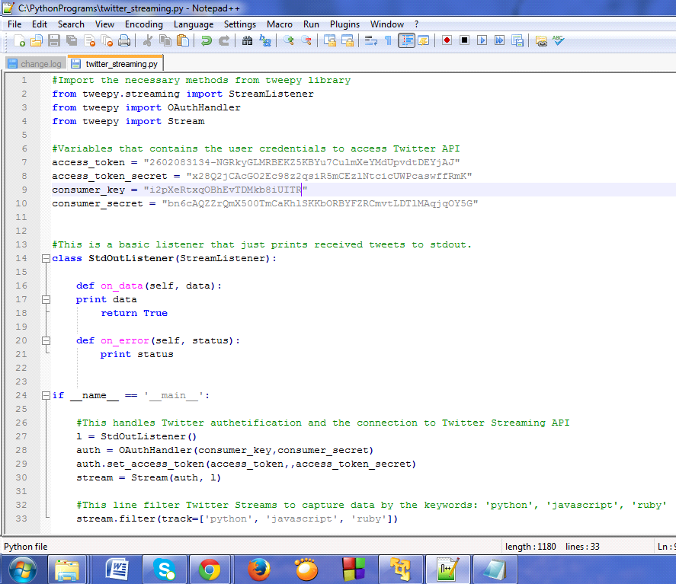

Slide 9
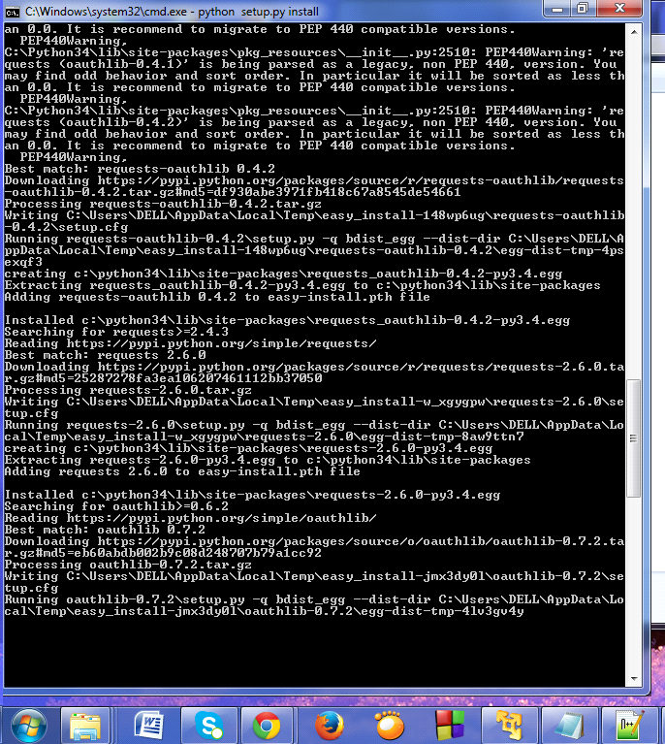

Slide 10
2. NODEXL
NodeXL is a general purpose network analysis application that supports network overview, discovery and exploration.
The tool enables the automation of a data flow that starts with the collection of network data and moves through multiple steps until final processed network visualizations and reports are generated.
1. Download the NodeXL setup from the internet
2. Run the NodeXL set up and accept the license

Slide 11


Slide 12
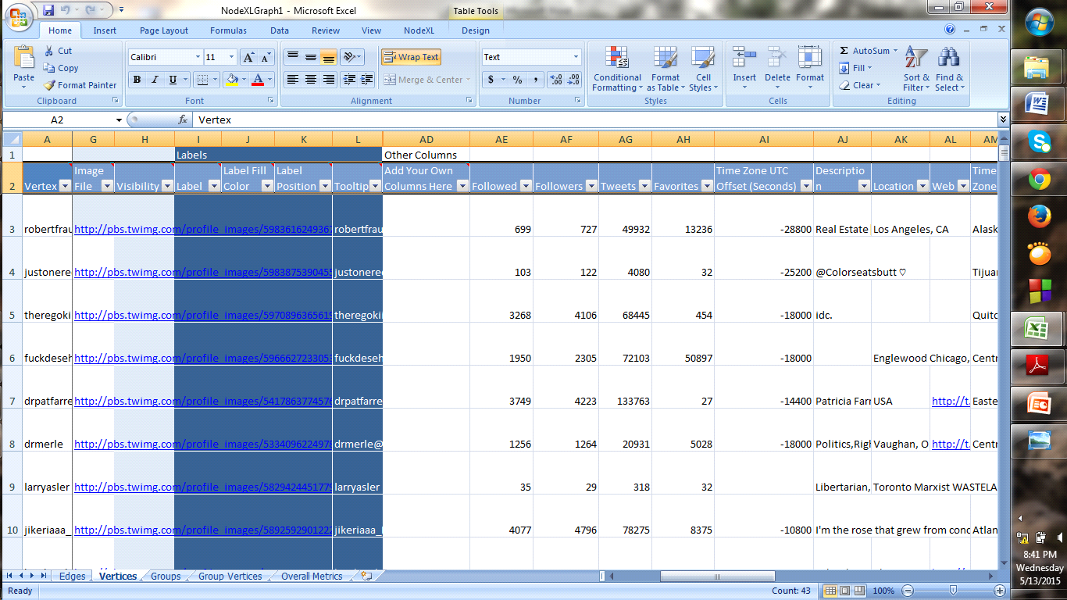
Importing Tweets

Slide 13
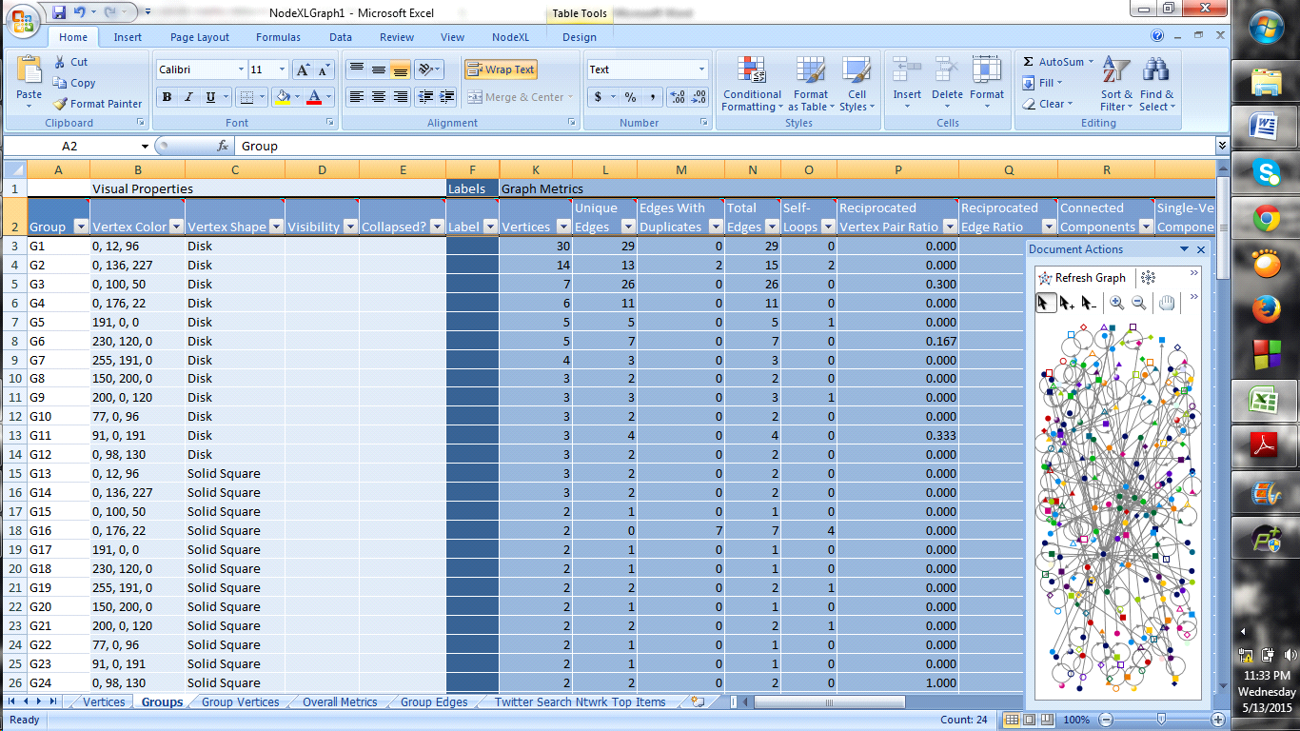
Graph metrics

Slide 14
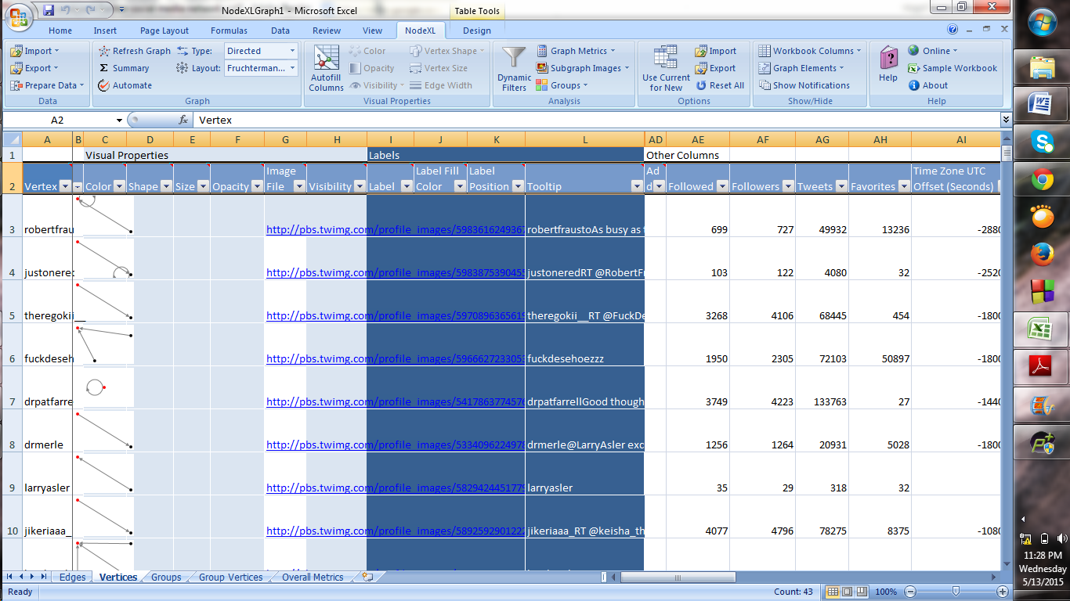
VERTICES

Slide 15
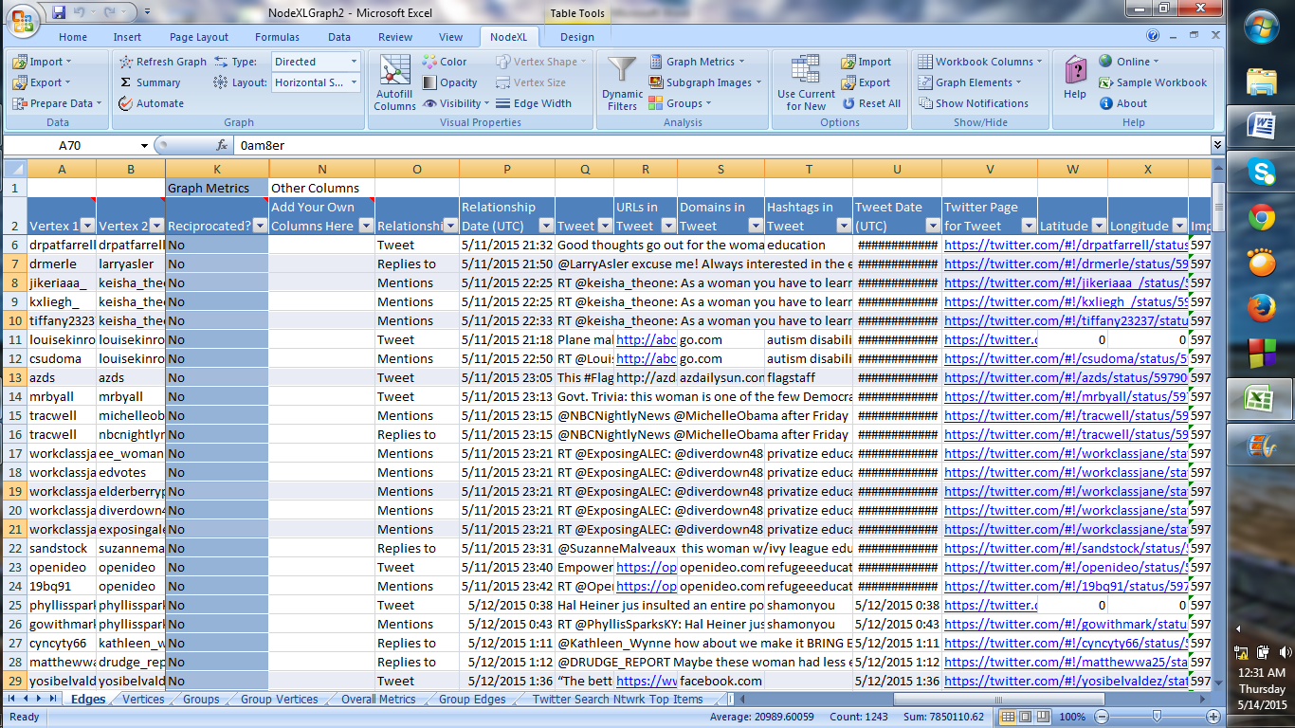
EDGES

Slide 16
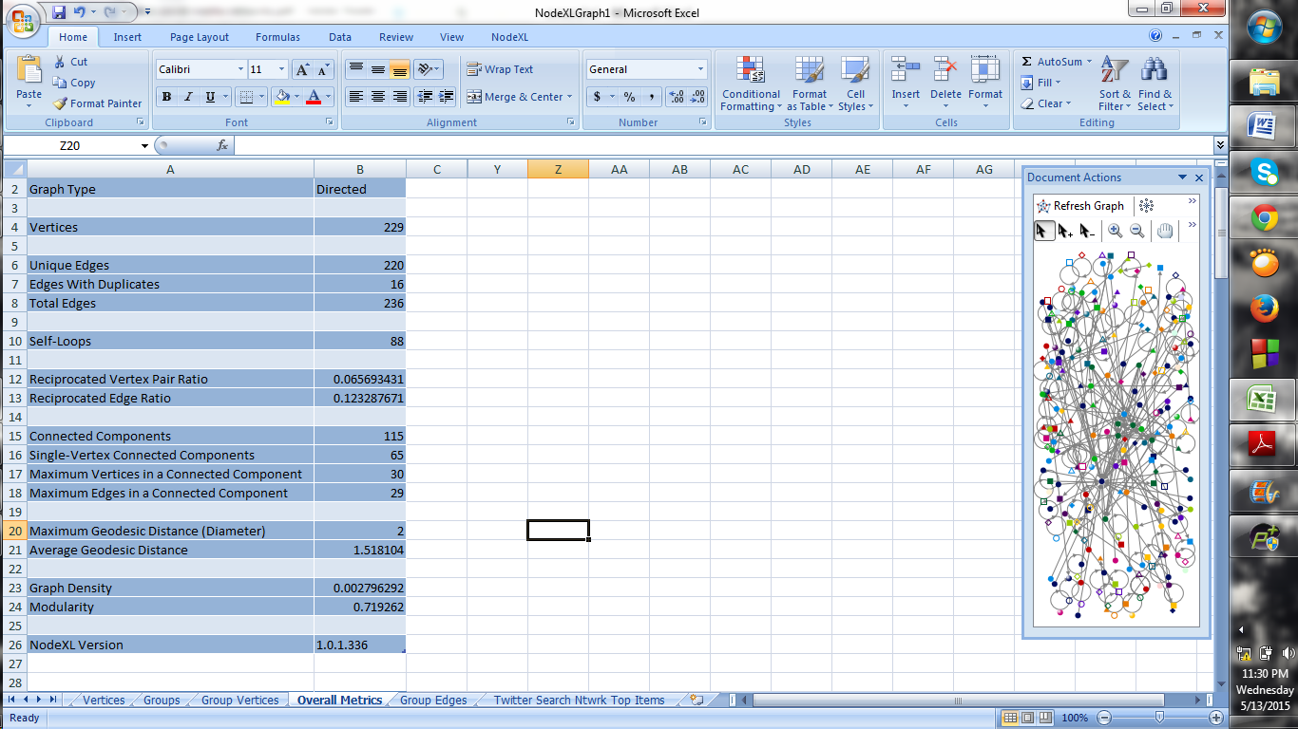
OVERALL METRICS

Slide 17
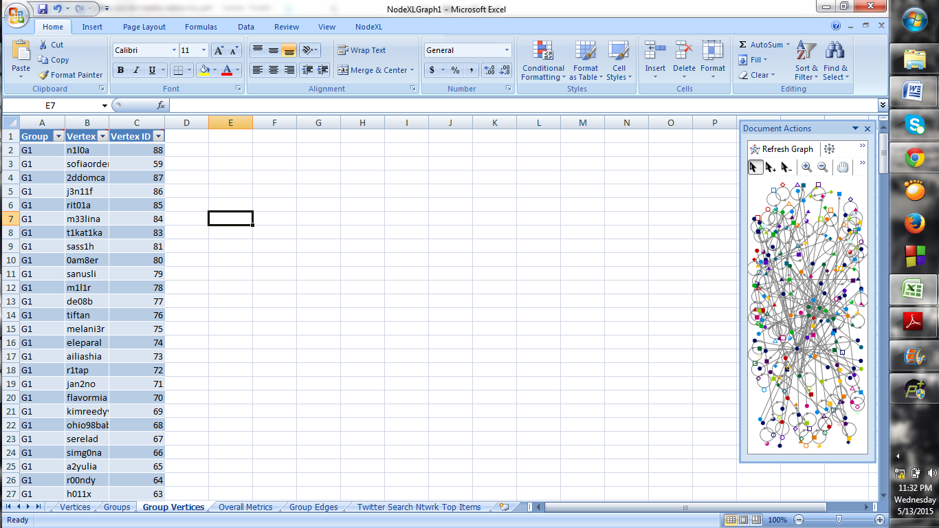
GROUP VERTICES

Slide 18
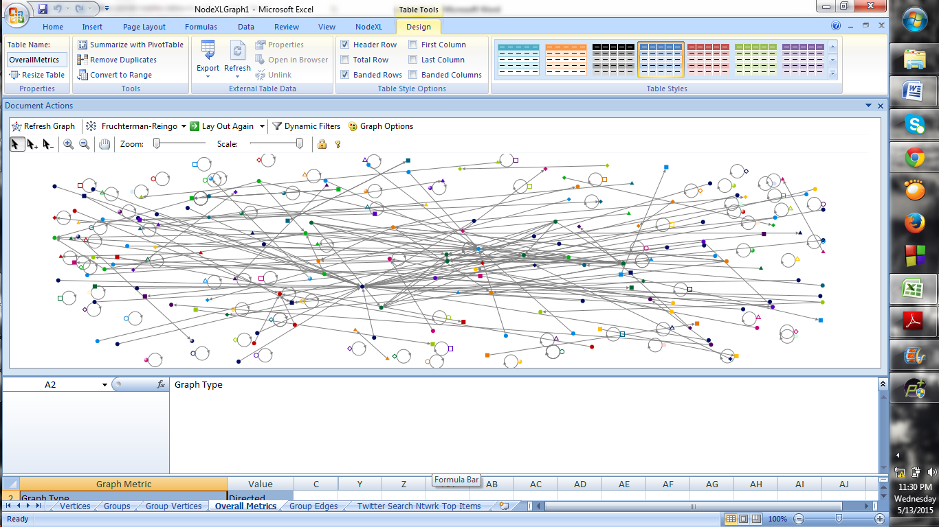
FrusterMan Reingold Graph

Slide 19
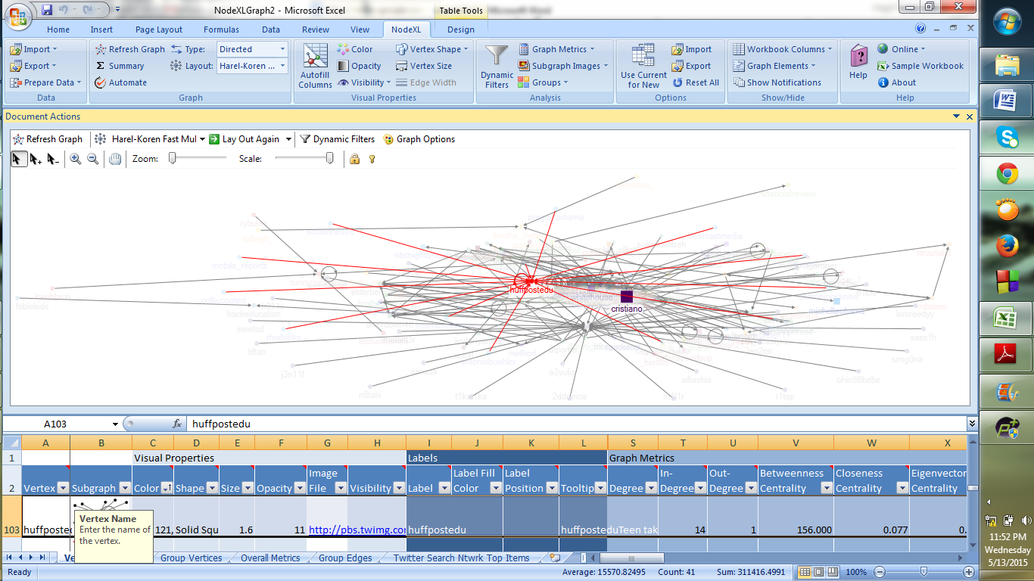
HAREL KOREN GRAPH

Slide 20
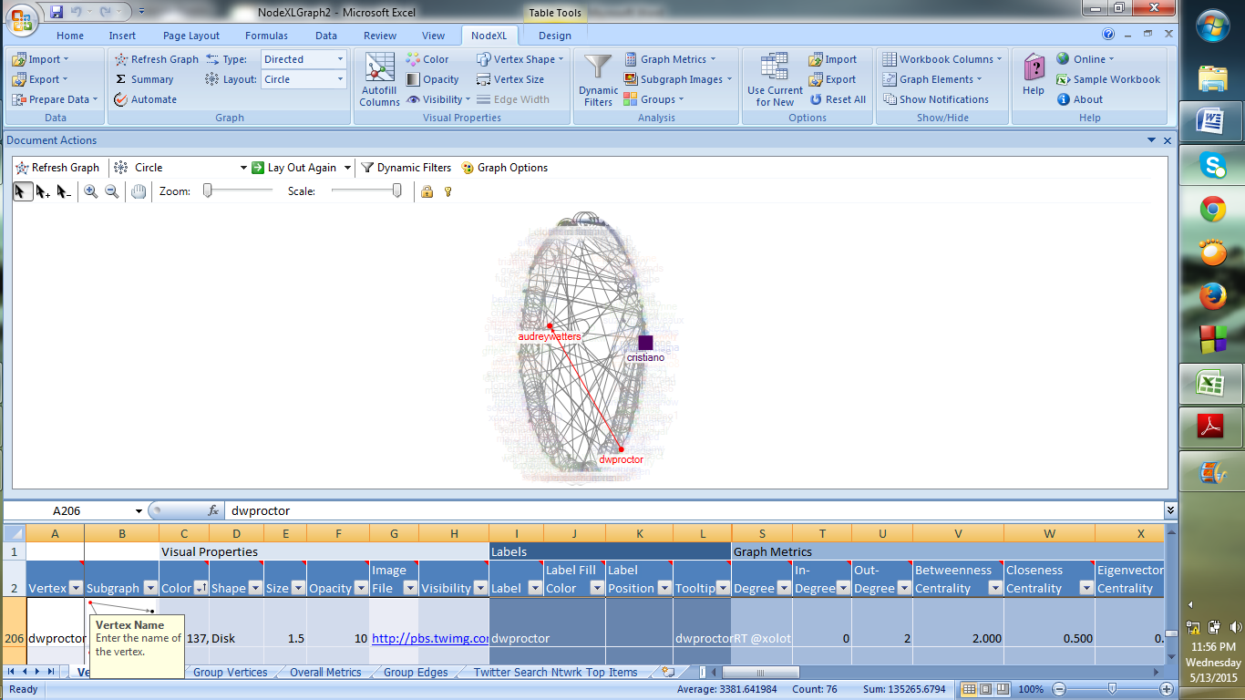
CIRCULAR GRAPH

Slide 21
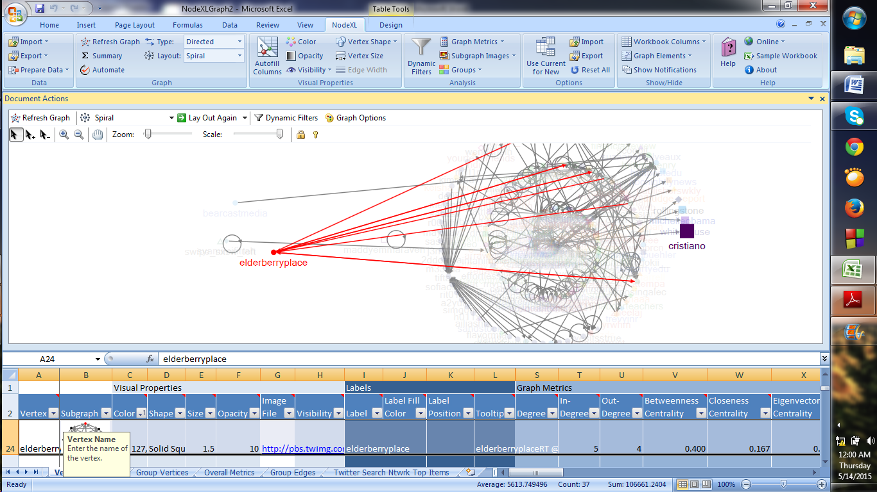
SPIRAL GRAPH

Slide 22
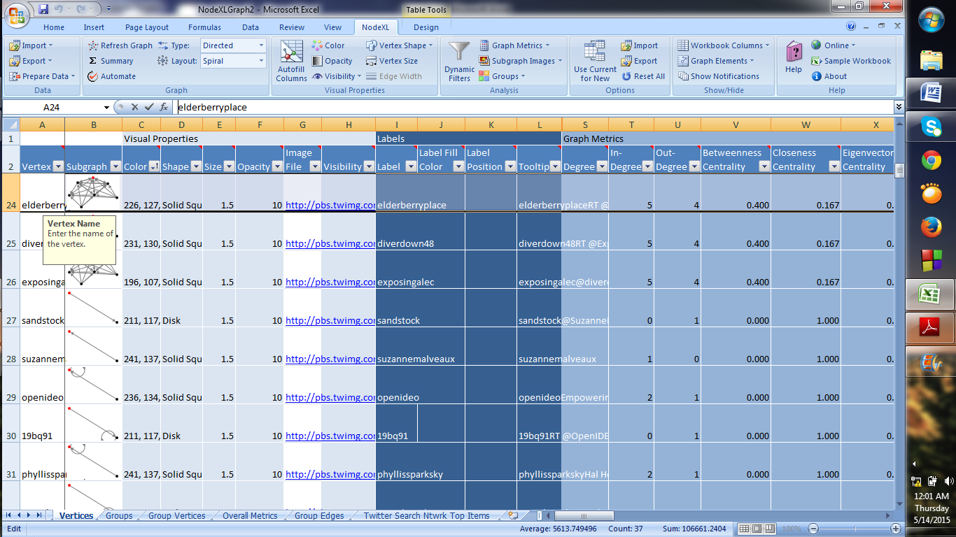
SUBGRAPH IMAGES

Slide 23
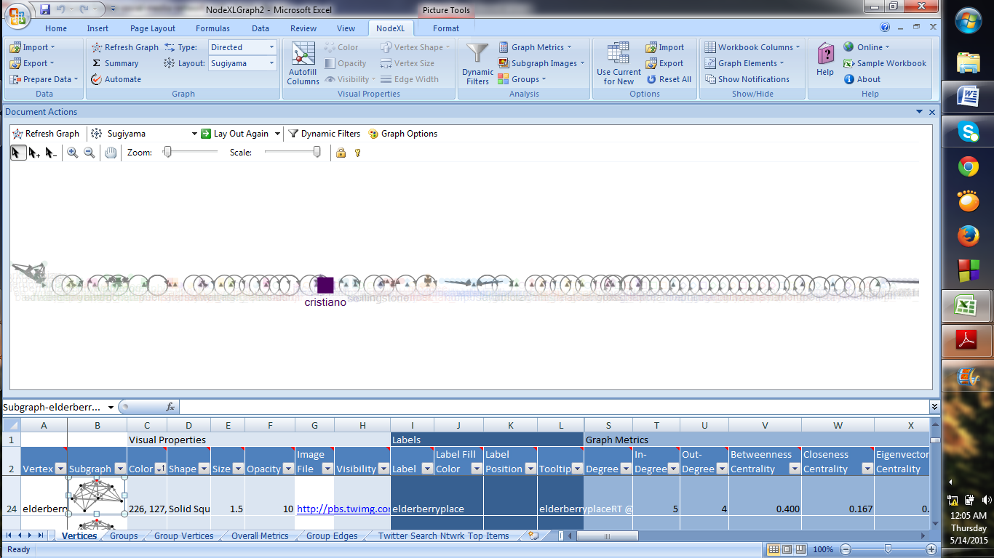
SUGIYAMA GRAPH

Slide 24
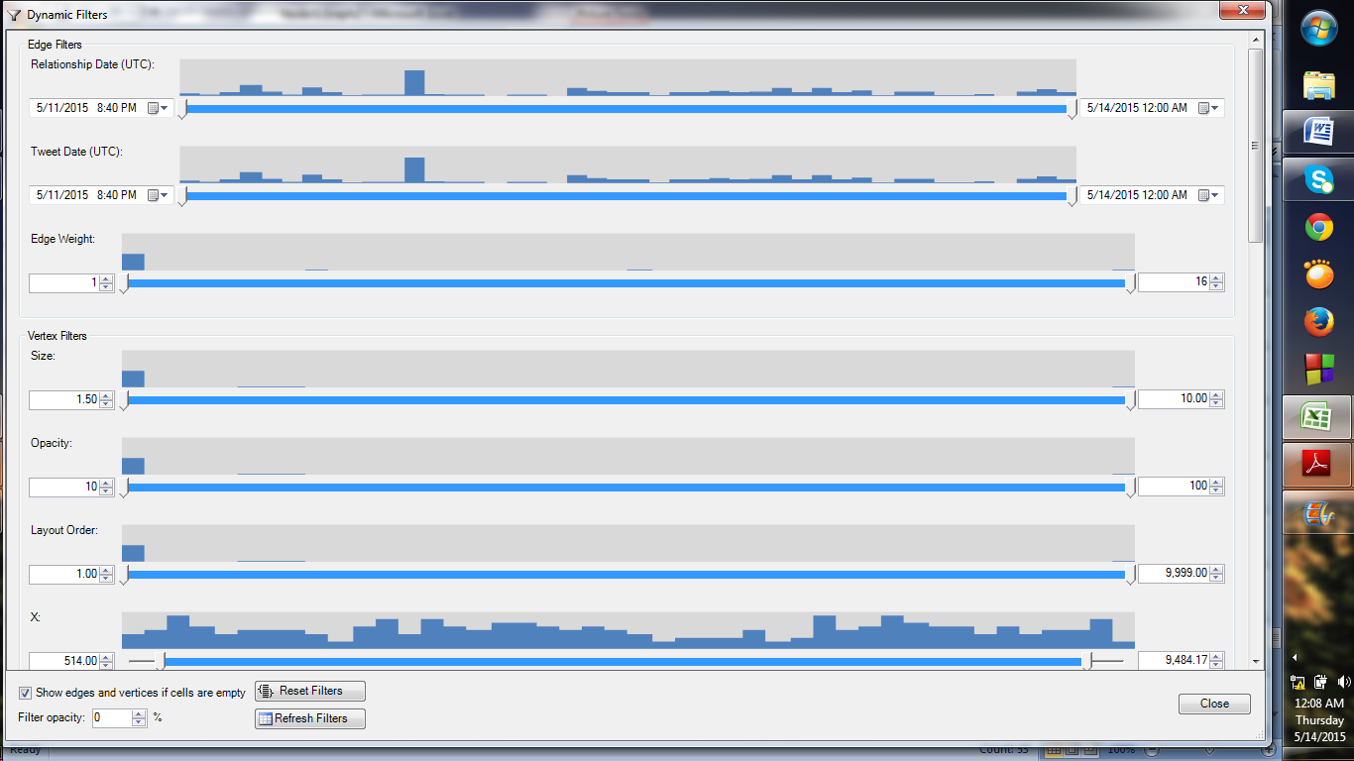
DYNAMIC FILTER

Slide 25
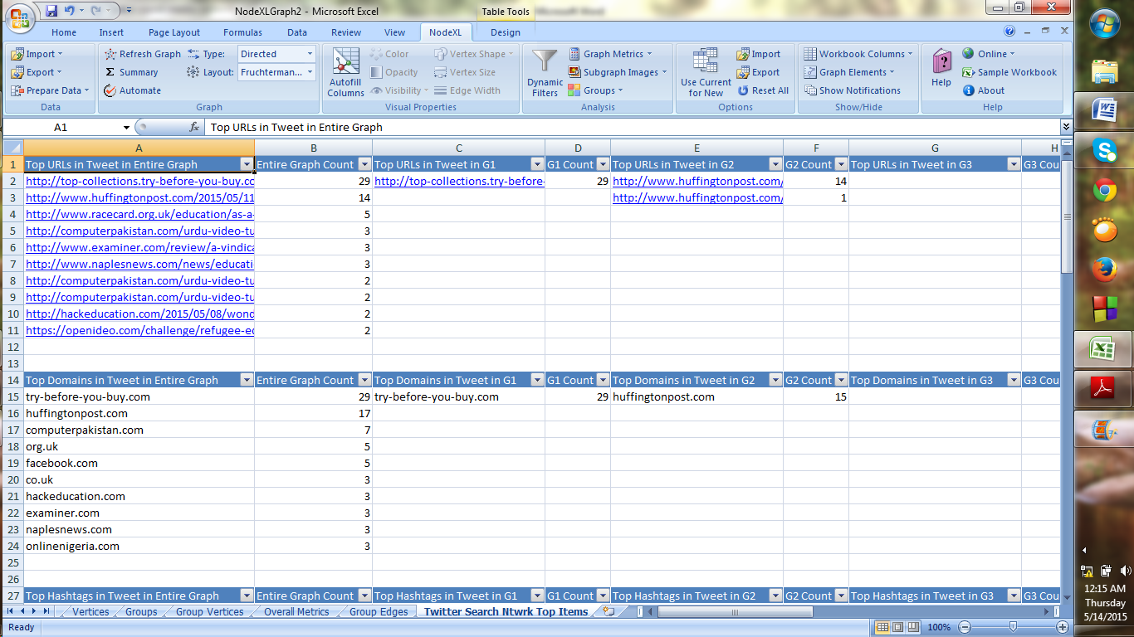
TOP URL and DOMAIN TWEETS

Slide 26
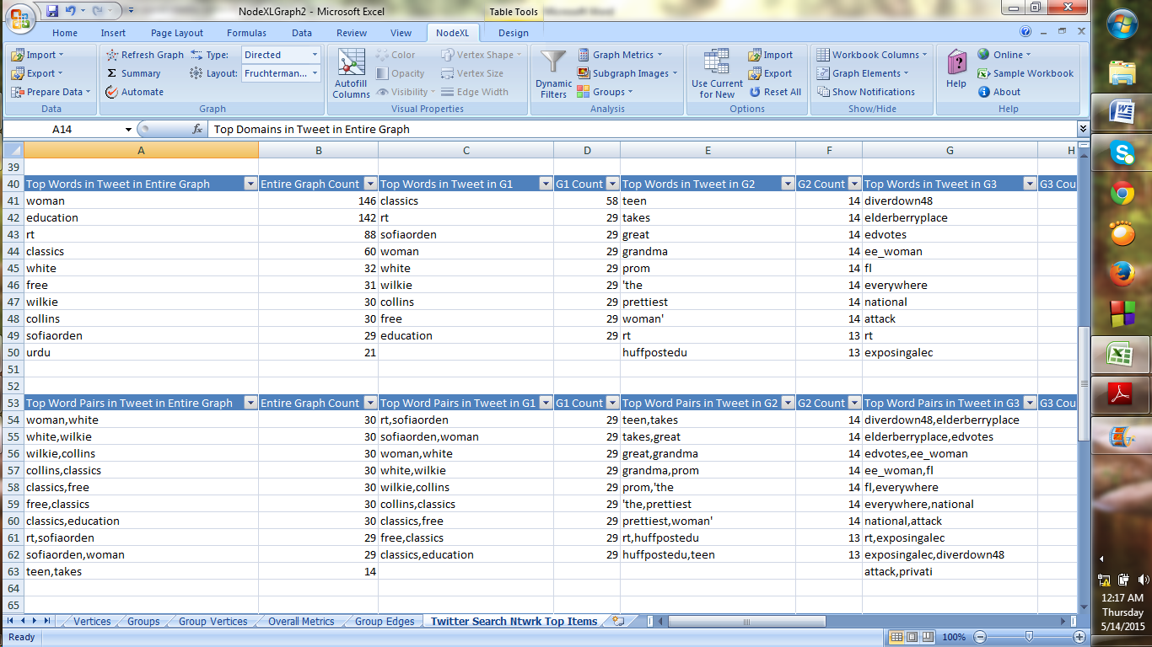
Top WORDS and WORDPAIR TWEETS

Slide 27
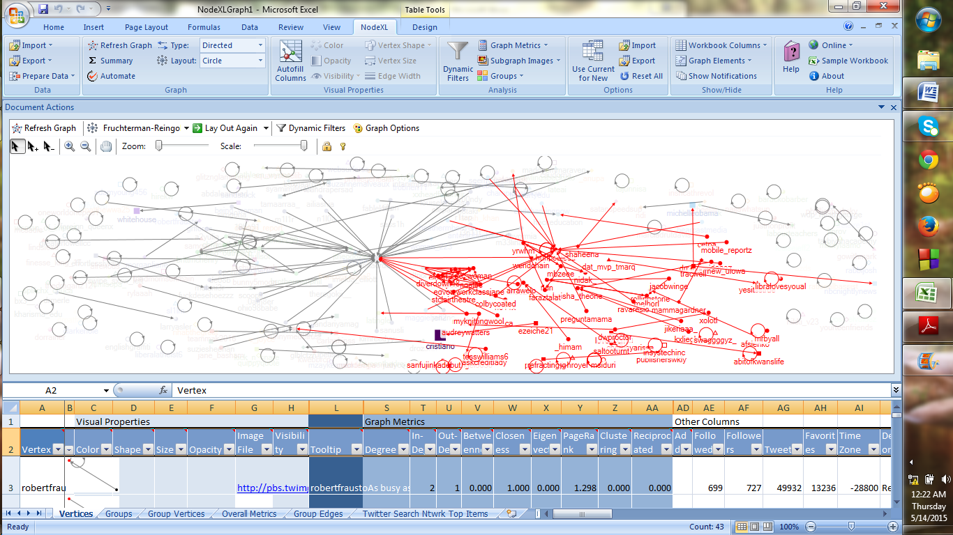
GRAPH FOR TOP WORD PAIRS TWEETs

Slide 28
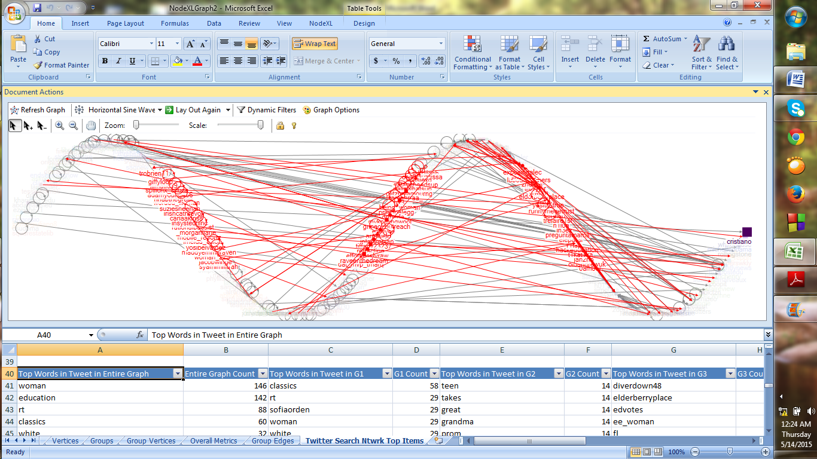
GRAPH FOR TOP WORD TWEETS

Slide 29
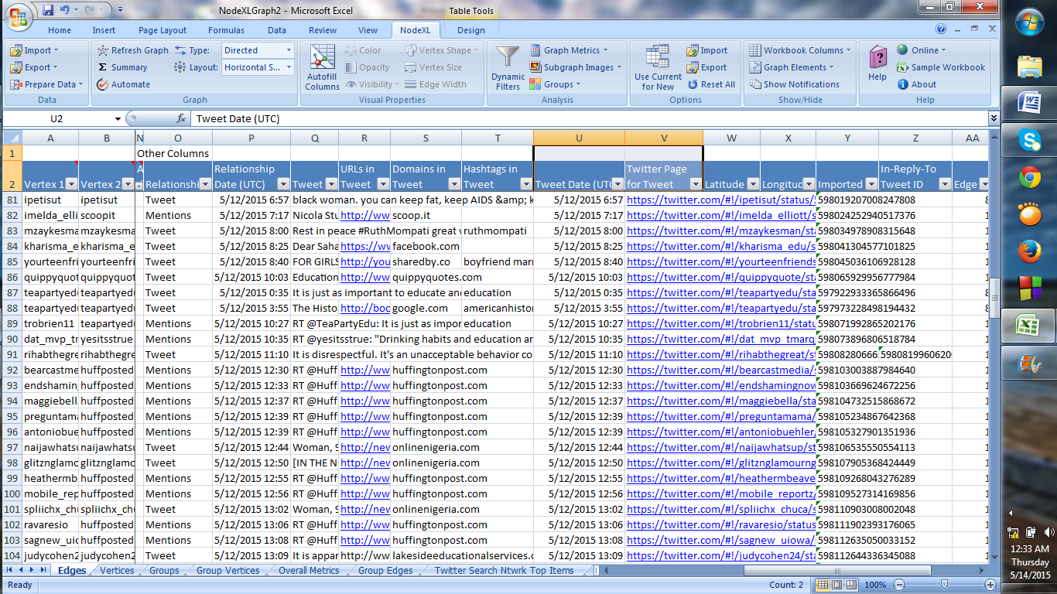
SORT TWEETS ACCORDING TO TWEET DATE-TIME

Slide 30
CONCLUSION
This project helped me understand the intricate process of Data Extraction, Transformation and Standardization. We could strengthen our understanding about Data Analytics and how we conclude the various issues on women’s education and employment.
The following proposed algorithm gives the result effectively and efficiently. The proposed code acquainted us with various such scenarios where minor mistakes would result in erroneous conclusions.
The project also helps to scan and analyze tweeter feeds so that we can permenantly keep upto speed on the latest developments in the industry and its environment.
After immense toil and guidance, the implementation was successfully realized and the extraction and statistical operations can now be smoothly executed within a matter of minutes. Further, we are going to implement this in real time environment.

Slide 31
KEY REFERENCES
[1] Smith and Shneiderman.”Analyzing social media with nodexl.” in University of Maryland , USA, 2011.
[2] Stephen G. Kobourov.” Spring Embedders and Force Directed Graph Drawing Algorithms.” in University of Arizona, pp. 4-9, 2012.
[3] Derek Hansen, Marc A. Smith, Ben Shneiderman.” EventGraphs: Charting Collections of Conference Connections.” in Connected Action Consulting Group, 2011.
[4] Derek Hansen, Ben Shneiderman.”Analyzing social media networks: learning by doing with Nodexl.” in University of Maryland, 2009.
[5] [Xindong Wu, Xingquan Zhu, Gong-Qing Wu, Wei Ding.]”Data Mining with Big Data,” IEEE Ttransactions on Knowledge and Data engineering., vol 26, no 1, January 2014.

Slide 32
THANK YOU !!

